Slide 2
Office Platform
Christine Matheney

Slide 3

Who is Christine?
Developer Evangelist, Microsoft
Mountain View, CA
@matheneyc
Christine.Matheney@Microsoft.com
http://aka.ms/christine
Office 365 Dev lead for the US
This is new content, please give us feedback!

Slide 4
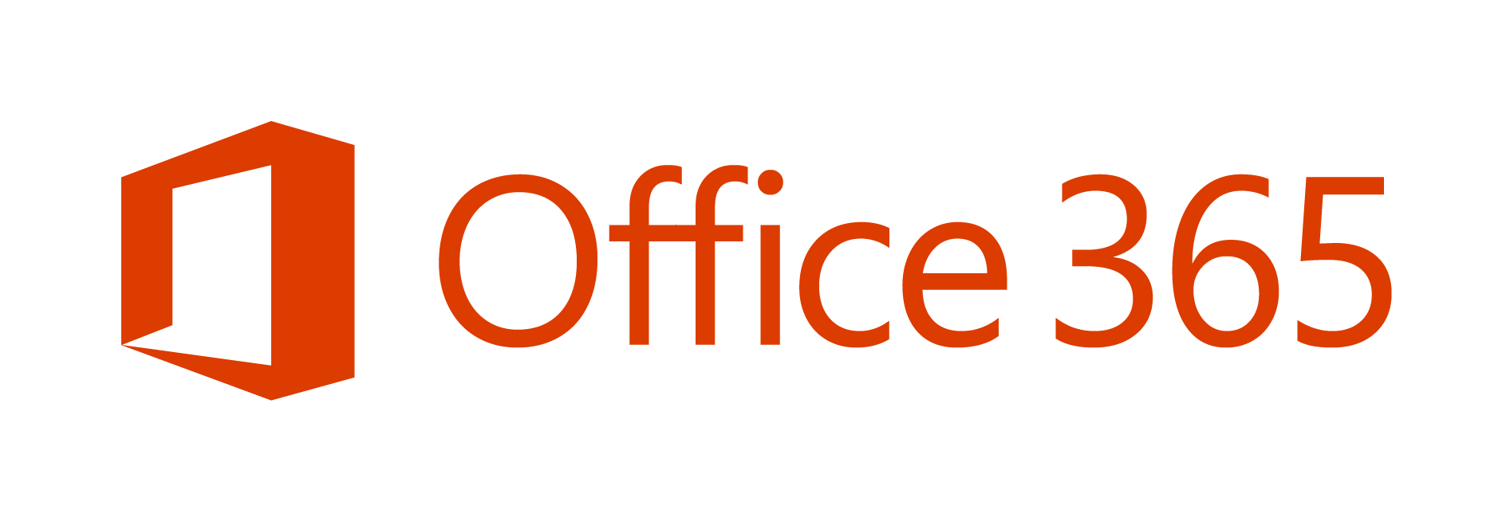
Platform Overview
Partner Opportunity
is one of the fastest growing businesses
in Microsoft history.
Platform Investments
Offers
Notes:
Tremendous momentum with Office 365
Over 1B people use Office
1 in 7 people on the planet

Slide 5



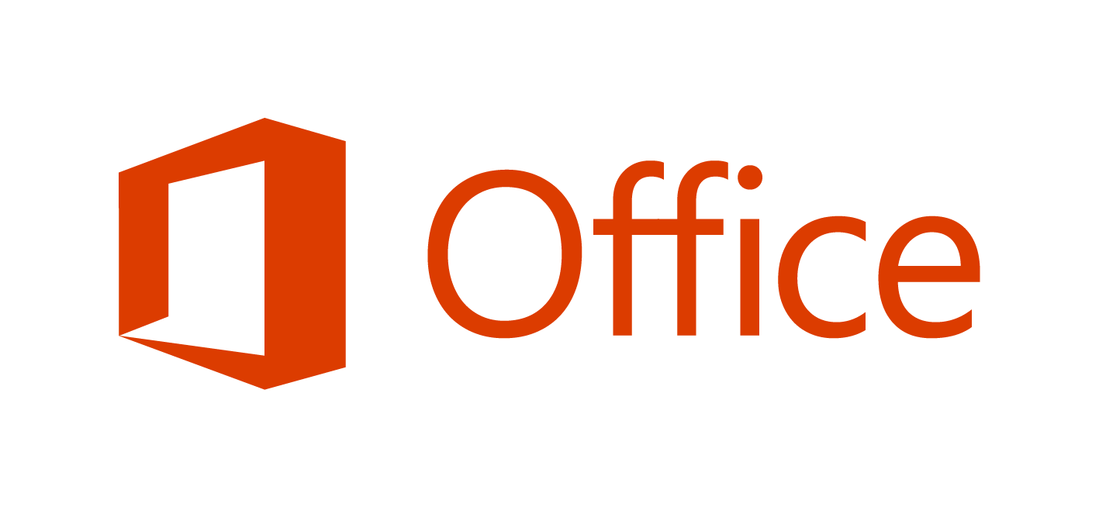
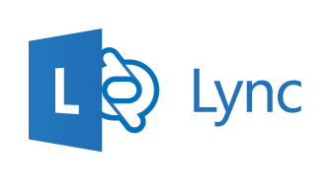
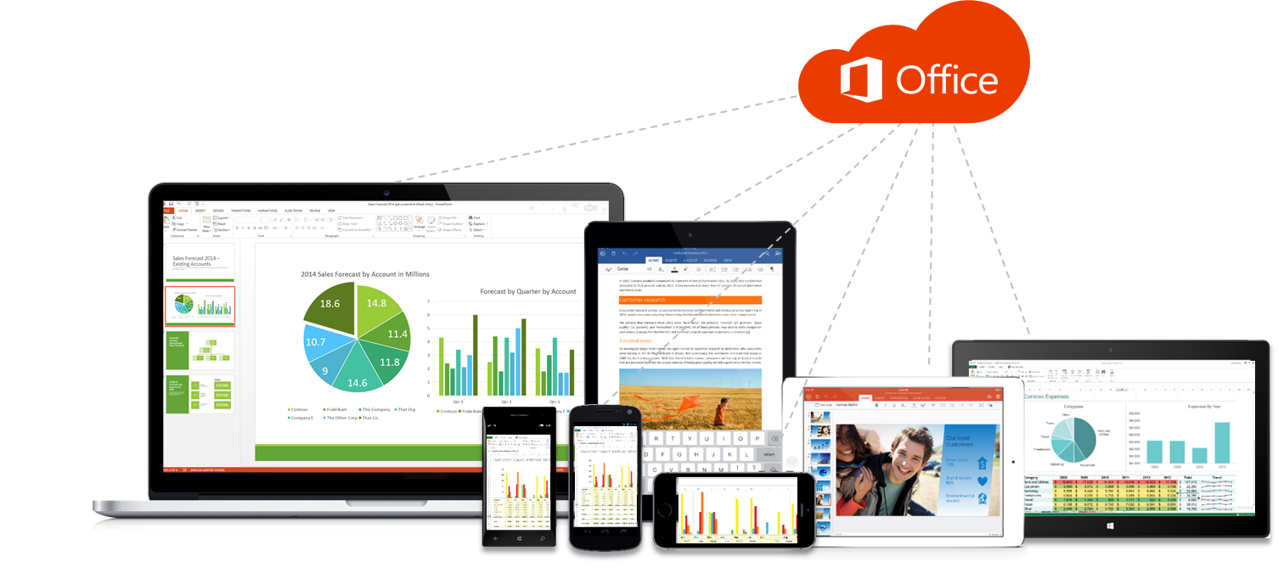

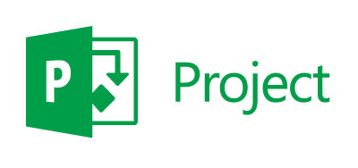
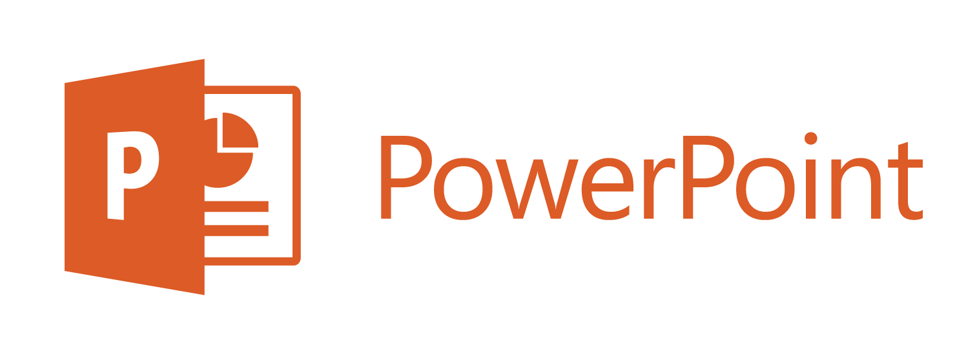
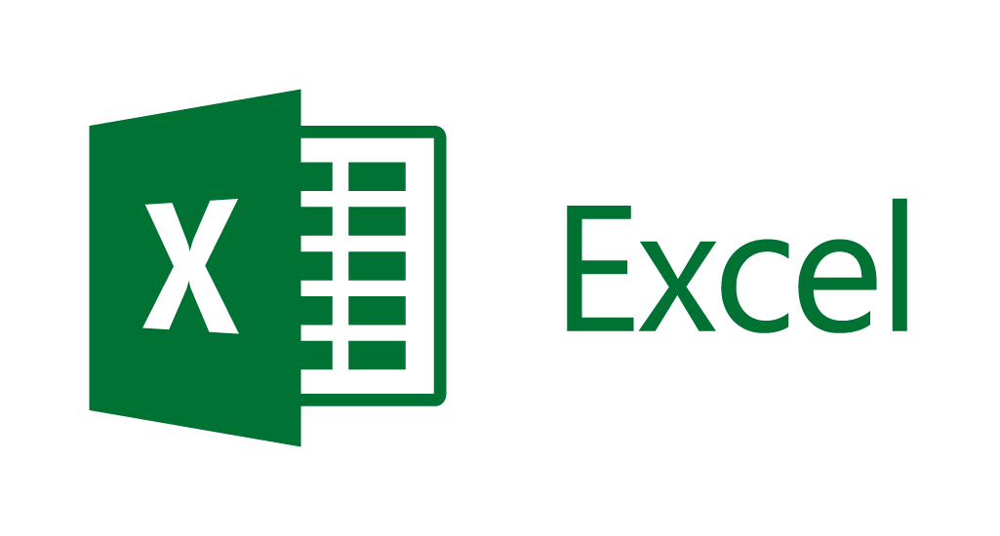
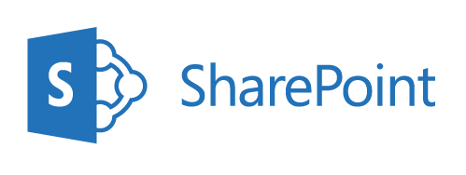
APPLICATIONS
SUITES & SERVICES
Office Apps On Any Device
20 consecutive quarters of triple-digit customer growth y/y, since launch in FY09
Office 365 is now on an annual revenue run rate of $2.5 BILLION
(as of 4/30/14)
Office 365 is Microsoft’s fastest growing commercial product ever
70% of Fortune 500 companies have purchased Office 365 in the last 12 months
Office 365 Home now has 4.4 million subscribers, adding nearly 1 million subscribers in just three months (as of 4/30/14)
Notes:
Office 365 Home & Personal
More than 5.6M subscribers
Added over 1M subscribers in last quarter (end of FY14)
20 consecutive quarters of triple digit customer growth since FY09
Over 50% of Office 365 revenue coming form international markets
Not just US but WW
Office 365 commercial seats nearly doubled y over year
Over 80% of enterprise customers are in more than one workload
Not just email, but in multiple workloads
70% of Fortune 500 companies have purchased O365 in last 12 months

Slide 6
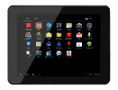

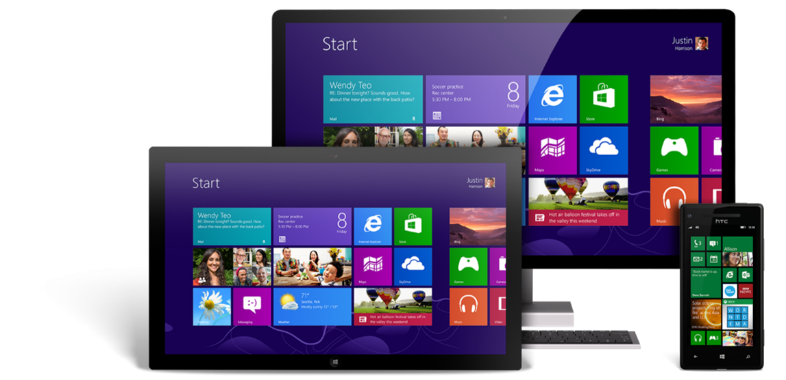



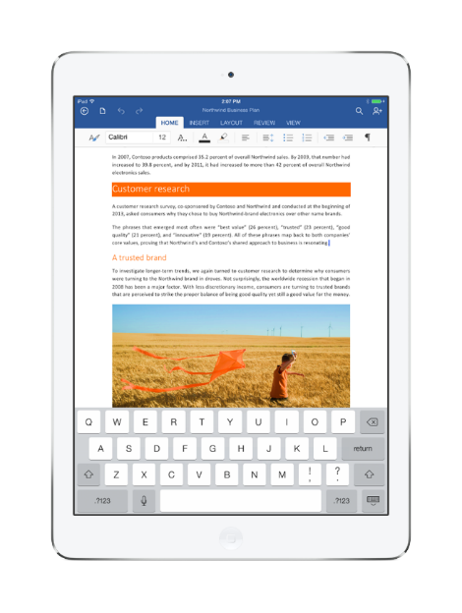


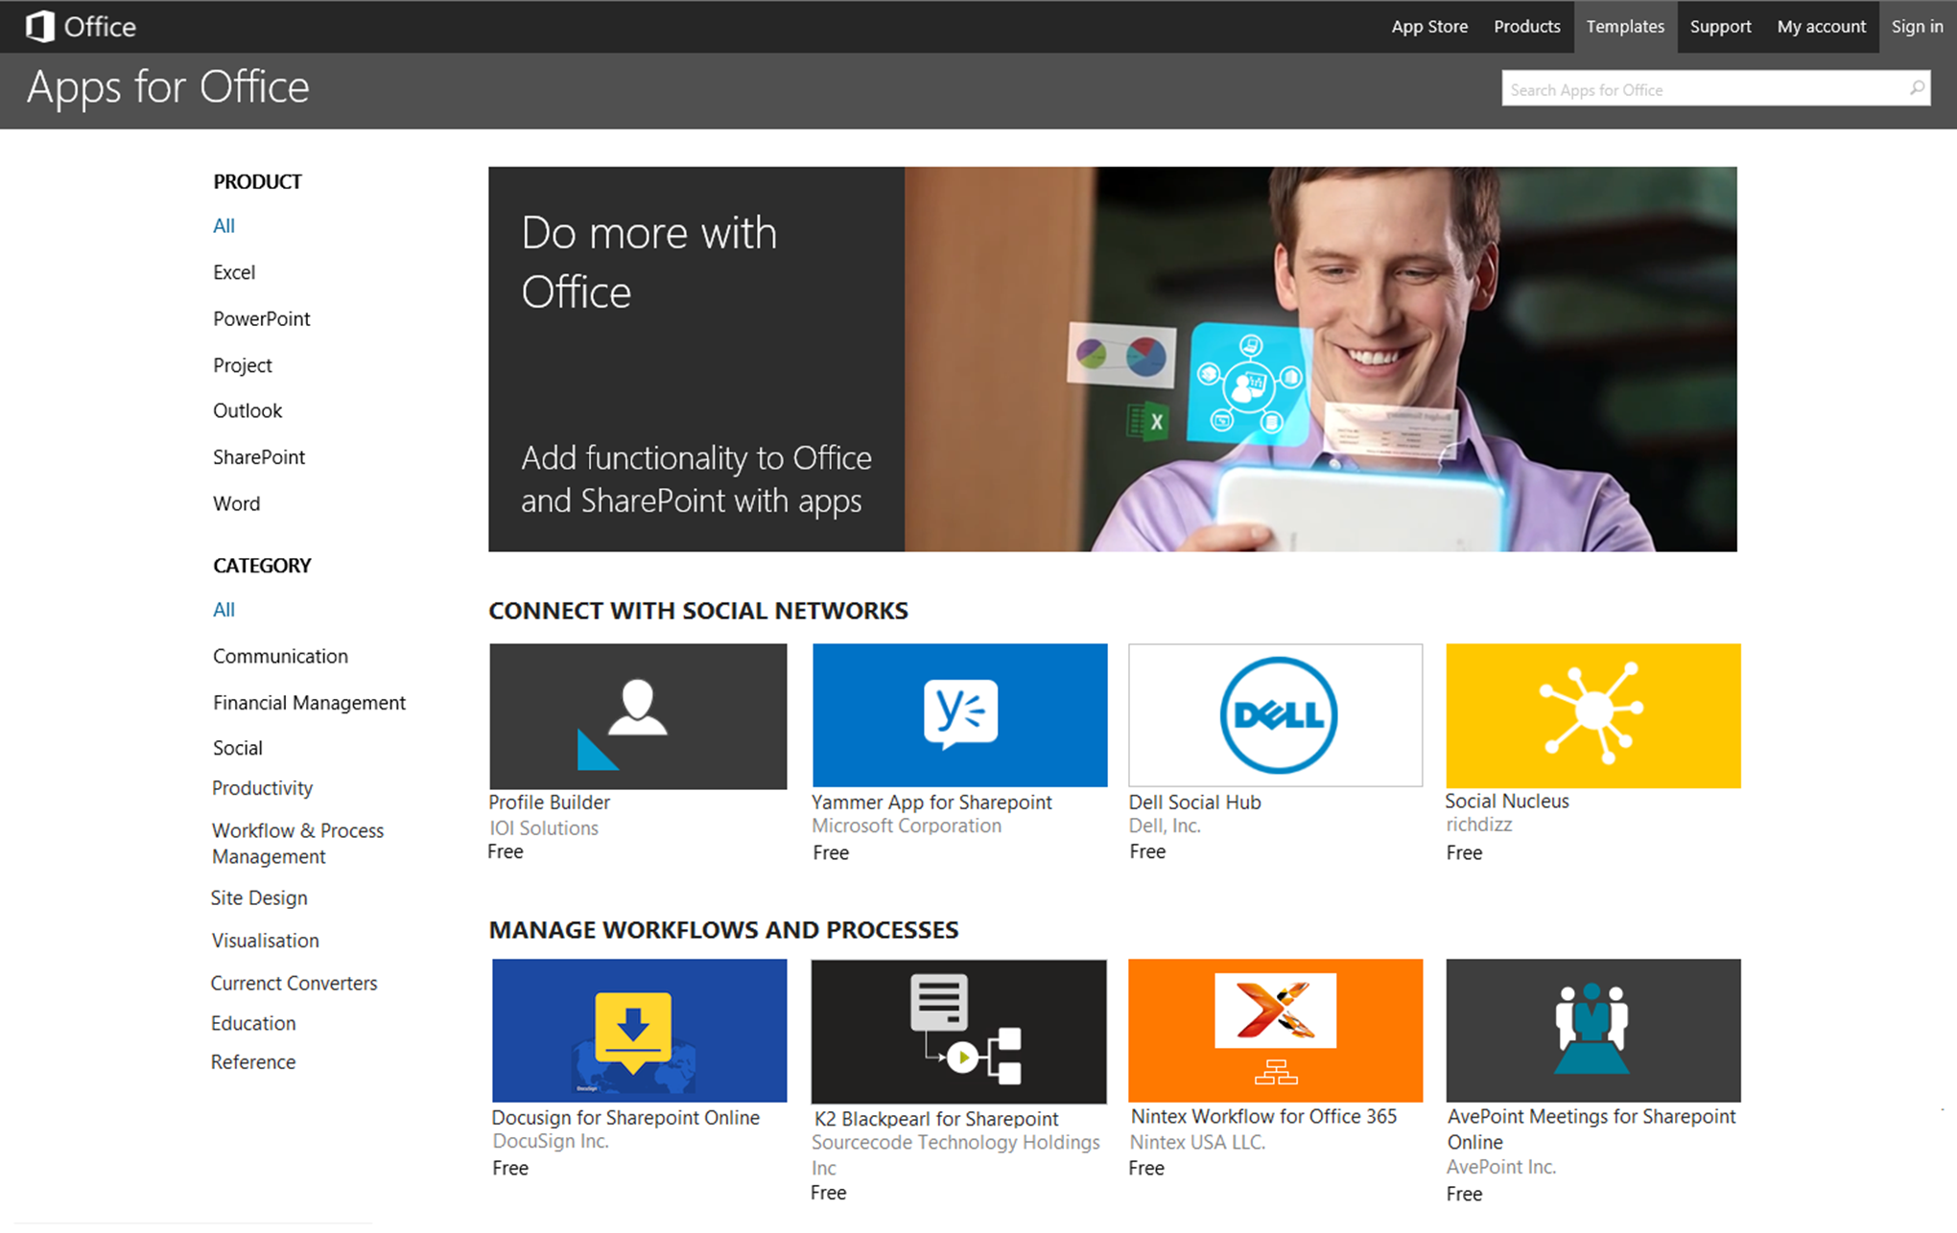

Momentum
Continuous Innovation For Office Apps
Connect Native Apps To O365
Apps
Flexible Tools. Open Platform.
Key Partnerships Store Expansion
“Office For iPad apps notch 27M downloads
In 46 days”
AppleInsider.com
Other Services
Notes:
Mobile devices are trending up
1.8B devices projected in 2018
Office runs on all of them
More than 35M downloads of the Word, Excel, PowerPoint & OneNote by end of last FY14
Microsoft is working to make apps work in Office for iPad in the future
Office is where people spend their time… multiple hours per day
Office isn’t just the client…
Office is a service
There is much more than 400PB of content in the Office platform

Slide 7
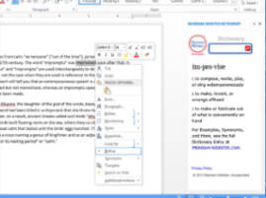
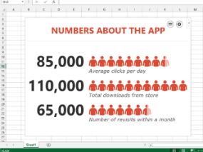
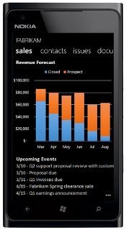
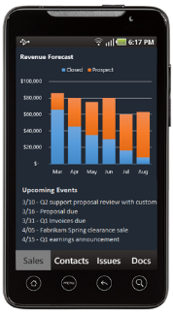
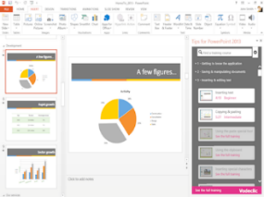
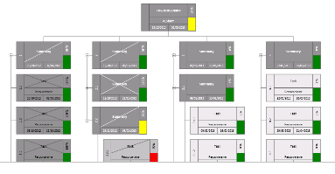
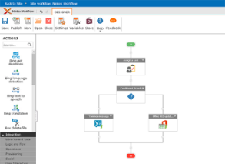

Office 365 Development Platform
Robust Office 365 APIs
Contextual Apps
Flexible Tools
Documents
Search
Mail
Social
Calendar
People
Notes:
What to build?
Contextual Apps
Robust APIs
Flexible tools
Contextual Applications
You can build rich experiences in the apps that your customers are currently in.
This extensibility is all about making a richer and more relevant experience for your users
Not just in Office clients..
But also in Office 365 in the browser, Office Online, and in the mobile clients
These also extend beyond Office and into SharePoint like workflow and LOB applications
Robust APIs
While extending Office both on the client & in the browser is great, customers don’t want to stop here…
They want to build custom applications…. Such as
Custom web applications
Custom Lob application extensions that hook into Office 365
Custom iOS applications
Custom Android applications
Custom Windows 8 applications
Custom Windows Phone applications
With the robust APIs, you can very easily and quickly create beautiful applications that that talk to Office 365
Leverage the APIs for Office 365… a robust set of APIs that are based on REST, a common & popular web standard for exchanging data
Imagine doing a Windows 8 appliction that is a customer dashboard or customer information, but also displays customer data from office 365 that really drives home the Microsoft Cloud First, Mobile First story
Flexible Tools – How you build applications
Office 365 is deeply integrated in Microsoft Azure
Even if you don’t use the .NET stack, Microsoft Azure is very friendly to other technologies and platforms like PHP, Linux, Java… you name it
In fact Satya Nadella has said that over 20% of the virtual machines in Microsoft are are Linux VMs!
But with this being said… Office 365 is very open so you are not tied to Azure because the APIs are founded on REST so you can use any platform you like… there is just deep integration with Microsoft Azure
What can you build – Development Platform
You can build things that work in Word, Excel, PowerPoint, Publisher, Outlook & SharePoint
What APIs are available?
Mail, Calendar, Contacts and Files with many more coming in the future
You can do end to end solutions very easily too
One example is Delve by Microsoft
This is built on top of their own APIs, namely the office graph API, to create very cool and interactive experience for users in Office 365
Tooling

Slide 8


Distribution Choices
Office Store
App Catalog
Viral Adoption
Notes:
Different ways of distribution for their apps:
Office store
Public store
Allows anyone in the world down download & isntall their app in Office 365, SharePoint 2013 on–premises & Office
Private app catalog
Private store of curated applications
Think of this like the company store
Many ISVs actually use both distribution models
How to access the store?
Within the Office desktop clients there is a tab group in the INSERT tab in the ribbon
Of course you can go straight to the store from a browser, but…
You can jump straight to the store from this tab…
look at all the apps you’ve installed…
Or access some popular apps that are specific to the client you’re in… such as in Excel the Bing Maps or People Graph app
This is available within the modern Office 2013 clients
Within Office 365, within SharePoint and Exchange, you can easily jump to the store to grab the content
How do you monetize your apps?
Free – Like Office for iPad or Nintex… the app is free… it’s free but you have to have a subscription in order to use the service
Trial – this is obvious… you can use a trial based on time or other metric defined in the app
Paid – you can have your own commerce model, such as Nintex, but you can also use the Microsoft commerce engine. If you do, microsoft does take a 20% share of the revenue from your app
Different licensing / payment options
Per-seat pricing
Organization wide pricing
Subscriptions
Microsoft is going to continue to invest this area, based on customer feedback!
So how big is the reach? The market reach is huge
131 markets
25 currencies
43 languages

Slide 9
Partner Opportunities
Existing
MS Partners
Upgrade And Extend Existing Solutions
New & Existing
Partners
Create New Solution Scenarios
New
Cloud Partners
Reach Millions Of Office Users

Slide 10



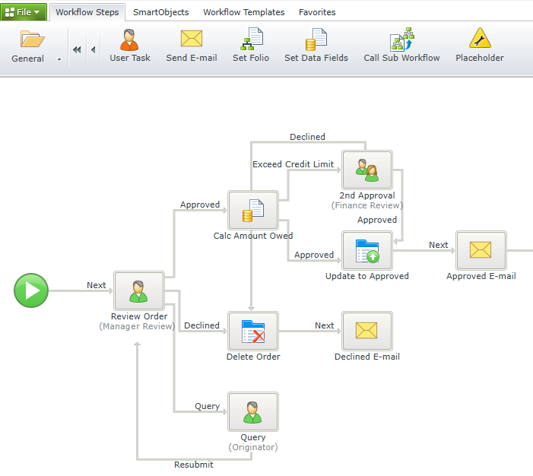
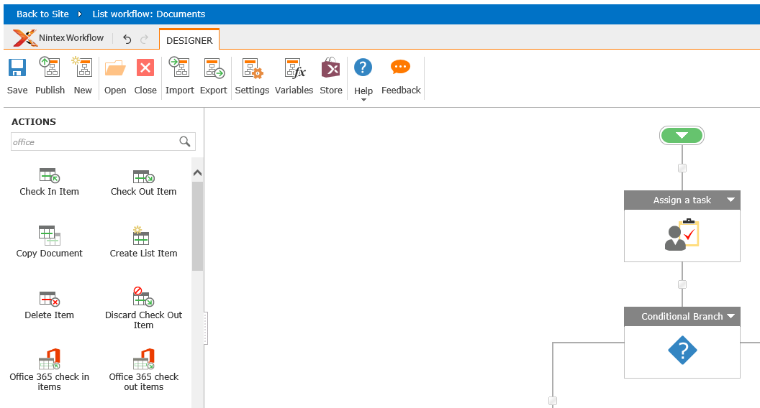
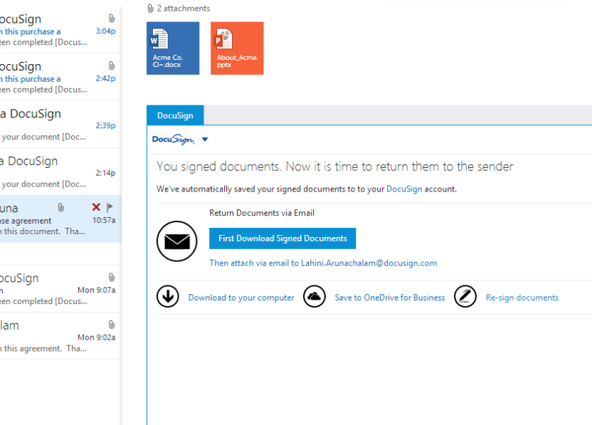
Examples
Notes:
Let’s look at some big win examples that some ISV have done on top of the Office 365 platform
Nintex – very popular workflow & forms vendors & available in the Office 365 store
Nintex uses Microsoft Azure from a developer platform
Full immersive SharePoint experience & integrate into the SharePoint ribbon
Great example of a company that creates extensibility points into Office 365 and using the Office store as a distribution model, can reach new customers they were not previously reaching in Office 365
DocuSign – the leader in digital signatures
Users get documents sent in email & sent in email & saved to their desktop
DocuSign has created extensions using the Office 365 platform and using the robust APIs
Now users can open their documents in any of these environments (desktop, web & mobile) and can seamlessly and contextually review and digitally sign their documents
What they’ve done is integration with Azure AD for single signon & contextual and beautiful experiences
Explain what the old story was like… then what the new experience is like
This adds value for DocuSign customers… but it also allows them to expand their user base by targeting Office 365 customers
PayPal – while not on the slide, it’s worth mentioning
This is a great example because everyone knows PayPal from the consumer world
It’s also heavily used for SMB payments
Through their work in creating an app for Excel as well as an Excel template..
In the last few months they have seen over 250,000 downloads which are both EXISTING and NEW customers
PayPal has added the integration to allow people to send and manage invoices from Excel with their addin, extensions & templates

